Slide 1
Gómez & Gómez Dual Language Program Programa de Lenguaje Dual de Gómez y Gómez
Dual Language Training Institute
Parent Meeting / Reunión de padres
2019 - 2020

Slide 2
Video: PSJA ISD K-12 DLE
Show Video

Slide 3
Purpose of Bilingual Education Propósito de la educación bilingüe
Learn knowledge & skills on-grade level using the native language while learning the second language
Aprende conocimientos y habilidades a nivel de grado usando el idioma nativo mientras aprende el segundo idioma
Knowledge and skills in the first language transfer to the second language
Conocimientos y habilidades en la primer lengua se transfiere a la segunda lengua

Slide 4
DLL Instructional Models
Additive/Enrichment
Subtractive/Remedial
Dual Language
- Two-Way
- One-Way
TBE - Late Exit
TBE – Early Exit
Content-Based ESL
ESL Pullout
Effective
Ineffective
Notes:
Purpose: There are various types of models for bilingual learners, but they are all under the umbrella of Bilingual Education
Salient Points:
Program models are either Subtractive and Remedial or Additive and Enrichment
Subtractive models “subtract” L1 learning at some point in program and are “remedial” because the focus is to “fix” the problem the child brings to schools (no English); as learners begin to fall behind academically, the curriculum is “watered-down.”
Additive Models “add” L2 learning and do not subtract L1 through at least 5th grade and are “enrichment” because learning is in both languages with no less than 50% of L1 instruction; Enrichment focus also positively impacts instruction as learners learn through a challenging, interactive and authentic environment
Subtractive/Remedial Models (listed from bottom up as least effective for Bilingual Learners)):
English as a Second Language (ESL) Pullout: By far the least effective because learners are pulled out of “mainstreamed/sink-or-swim” classrooms for English language development (ESL lessons); Former NABE Executive Director stated that there is so much evidence on the ineffectiveness of ESL Pullout, that its continued use is tantamount to “child abuse”
Content-Based ESL: Learners are placed in a self-contained classroom with ESL certified teacher all day (no pullout)
TBE - Early-Exit: Equally as ineffective as content-based ESL. Learners are “transitioned early” into all English instruction usually with a BE teacher and exited into “mainstream” as early as 2nd or 3rd grade
TBE - Late Exit: More effective as students are “transitioned gradually from L1 to L2” and exited into mainstream about 4th or 5th grade. Typically falls below 50% L1 instruction as early as 3rd or 4th grade.
Additive/Enrichment Models:
Maintenance Bilingual (also referred to as Developmental Bilingual Education): Early attempts to maintain or sustain L1 through 5th grade. Model type not widely accepted by mainstream.
One-Way Dual Language Enrichment (DLE): Enrichment model where majority or ALL students are from same language group learning together
Two-Way DLE: Enrichment model where there is a “balance” of two language groups learning together
Typical Questions:
Q: Does anyone implement Maintenance Bilingual?
R: There may be schools that are essentially using a maintenance bilingual program which is a step up from late exit TBE, but the term is seldom used.

Slide 5
Dual Language is for All Children! ¡Programa de Lenguaje Dual es para todos los niños!
Dual Language Program/Programa de lenguaje dual
All students learn in two languages
Todos los estudiantes aprenden en dos idiomas
5

Slide 6
Video: Dallas ISD / Distrito escolar de Dallas
2006: 143 Schools ➔ 2018: 153 Schools
2006: 143 Escuelas ➔ 2018: 153 Escuelas
Show Video

Slide 7
National Research - Models for Educating Spanish Dominant Students
Investigación Nacional: Modelos para Educar Estudiantes de Habla Español
(English Reading - Lectura en inglés)
Dual Language/Lenguaje Dual
1
1
2
2
Average reading score of native English speakers
El promedio de lectura para estudiantes de habla inglés
Bilingual Programs/Programas Bilingues
3
3
4
5
4
6
7
5
6
7
Program Implementation through 5th Grade only
Programa implementado solamente de K-5 grado
(Thomas & Collier, 2002)

Slide 8
Purpose of Dual Language Program Proposito de Programas de Lenguaje Dual
The number one predictor for long-term academic achievement in English is the extent and quality of L1 schooling found in dual language programs
El predictor número uno para el logro académico a largo plazo en inglés es el grado y la calidad de la educación en el primer idioma que se encuentra en los programas de lenguaje dual
(Thomas & Collier, 2002)
8

Slide 10
Instructional Program - Programa Instrucciónal
Students learn content together (bilingual pairs/groups)
Los estudiantes aprenden contenido juntos (pares bilingües y grupos bilingües)
Enrichment instruction challenges all students with high expectations
La instrucción de enriquecimiento desafia a todos los estudiantes con altas expectativas
Staff and students follow the Language of the Day
(MWF: Spanish / T and Th: English)
El personal y los estudiantes seguin el Idioma del Dia
(MWF: Español / T and Th: Inglés)

Slide 11
Impact of Gómez & Gómez DL Program
Impacto del Programa Dual de Gómez y Gómez
Most widely implemented DL program in the United States!
¡El programa de lenguaje dual mas implementado en los Estados Unidos!
Implemented in 144 school districts across 11 states
Implementado en 144 distritos escolares en 11 estados
Approximately 2 million students have been served through the G & G DL Program over the last 23 years
Aproximadamente 2 millones de estudiantes han sido atendidos en el Programa Dual de G y G en los ultimos 23 años

Slide 12
Impact of Gómez & Gómez DL Program
Impacto del Programa Dual de Gómez & Gómez
Any given year, the G & G DL Program is used in over 6000 classrooms and serves over 120,000 students
En cualquier año dado, el Programa Dual de G y G se utiliza en mas de 6000 aulas y atiende a mas de 120,000 estudiantes

Slide 13
Parent’s Role – Rol de Los Padres
Ensure that your child has opportunities to practice the second language at home
Asegúrese de que su hijo tenga la oportunidad de practicar el segundo idioma en casa
Follow the Language of the Day at home as much as possible
Sigue el Idioma del Dia en casa tanto como sea posible
Provide access to books, movies, cartoons, etc. in the child’s second language
Proporcionar acceso a libros, películas, debujos animados, etc. en el segundo idioma del niño

Slide 14
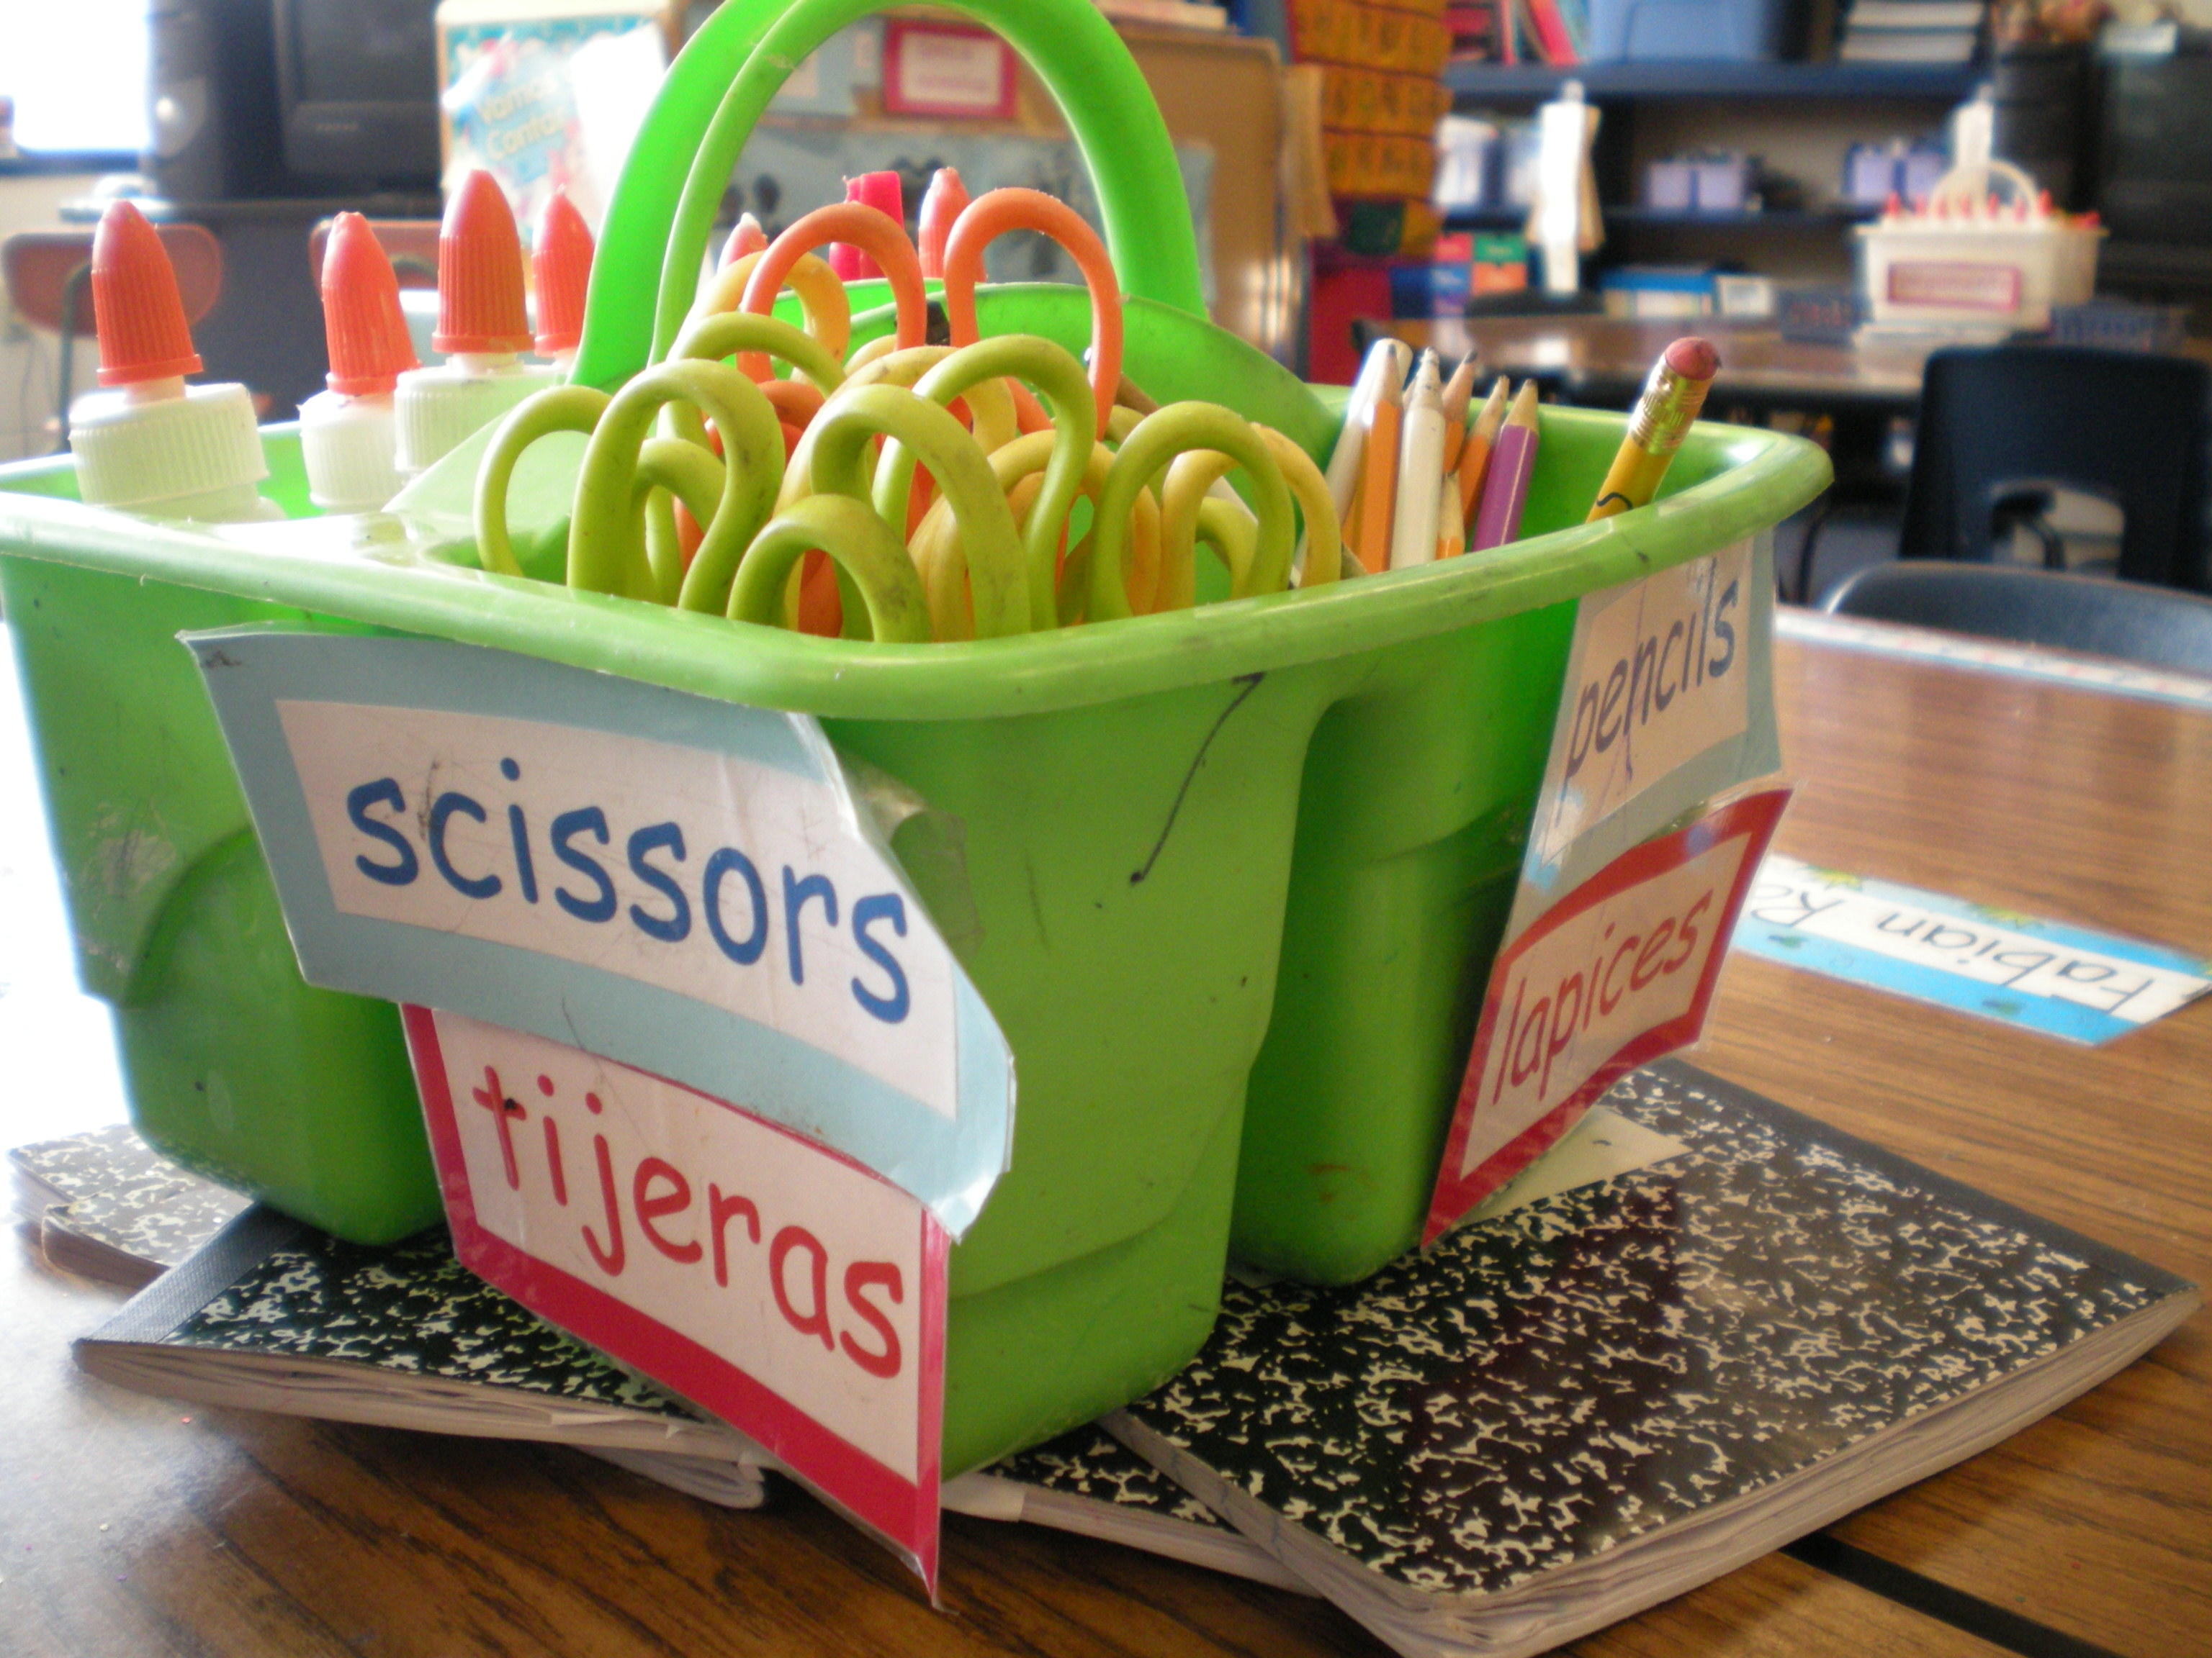

Slide 15
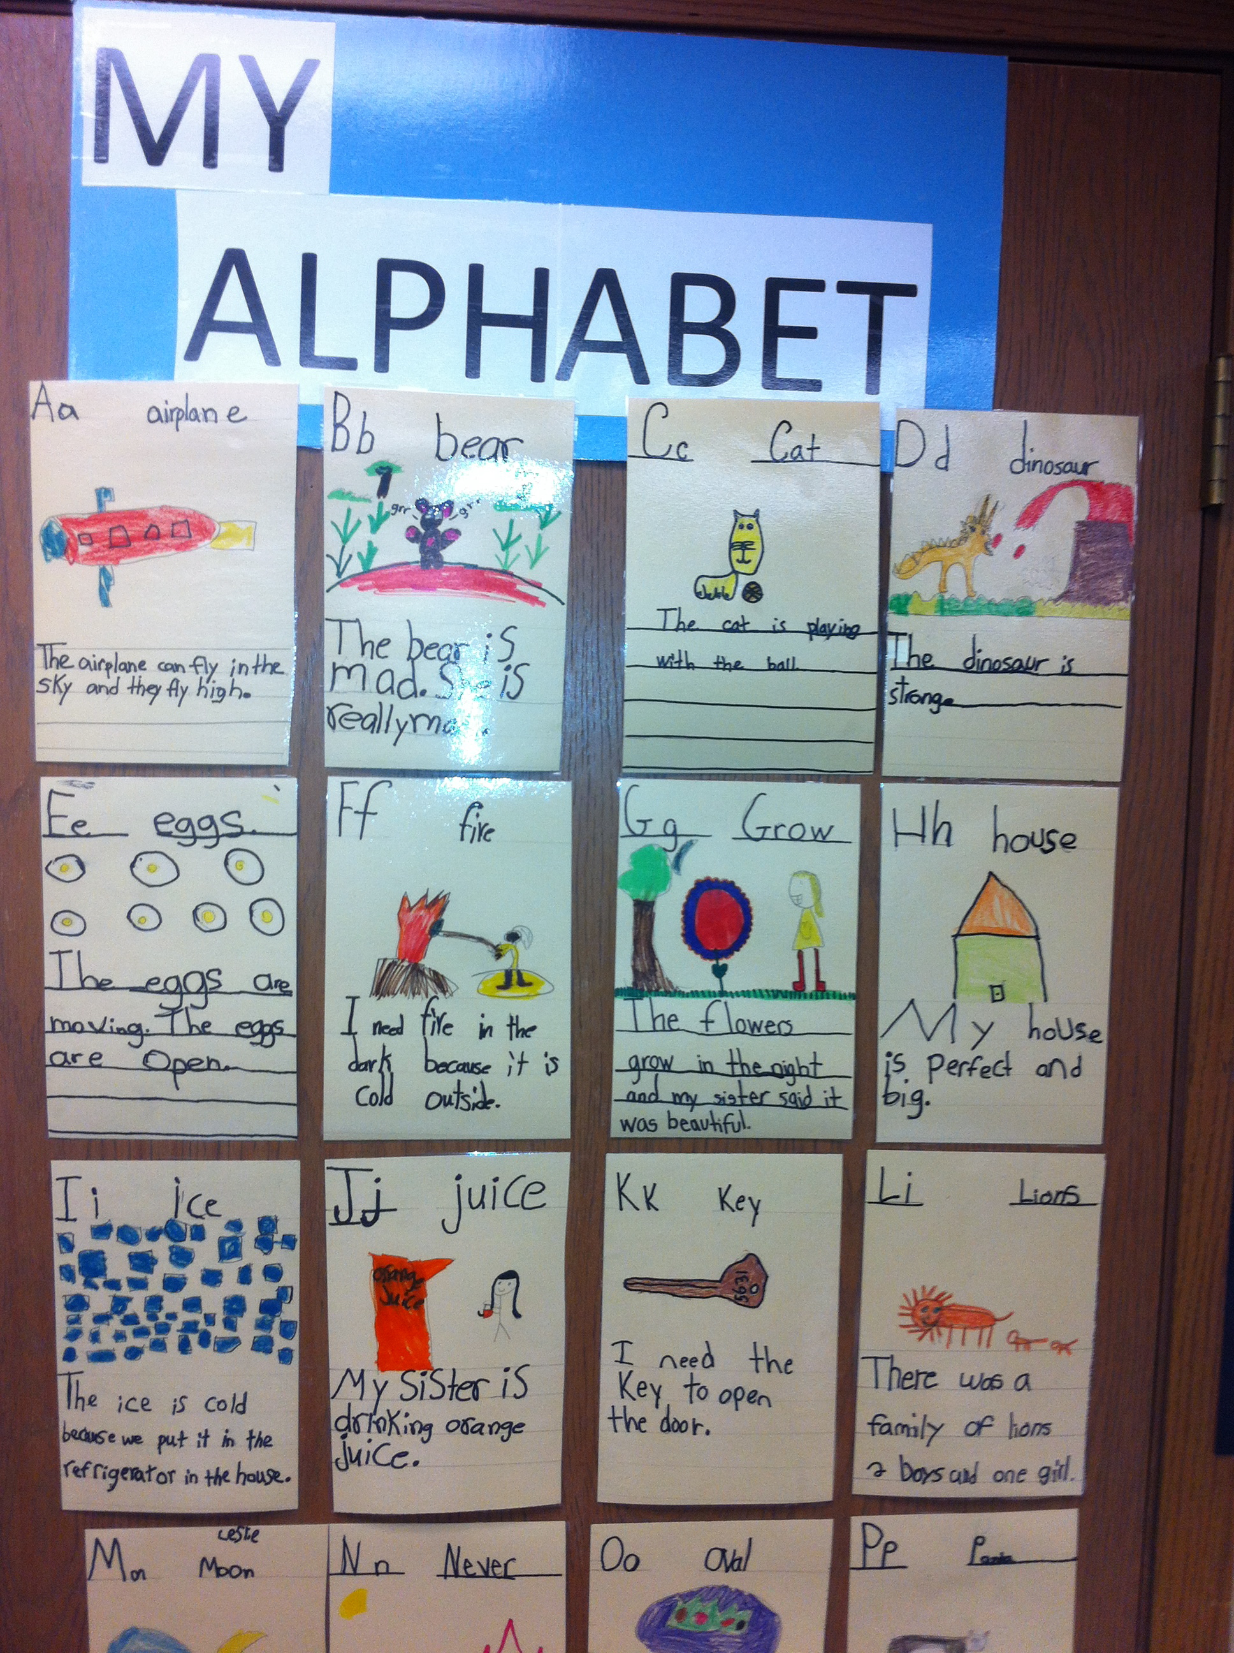

Slide 16
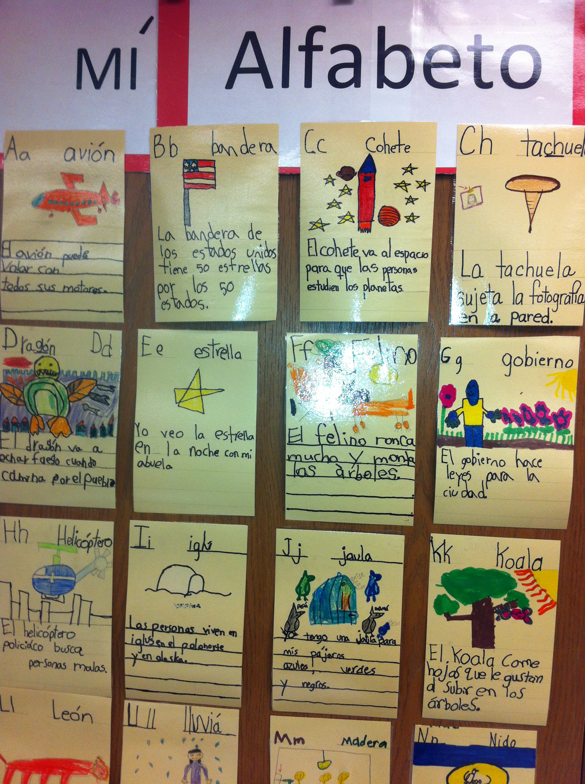

Slide 17
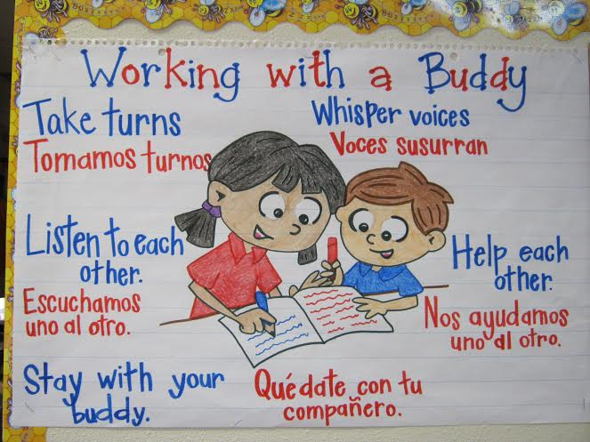

Slide 18
Bilingual Pairs – Pares Bilingües

Slide 19
Copyright © 2017-Dual Language Training Institute. All Rights Reserved.

Slide 20
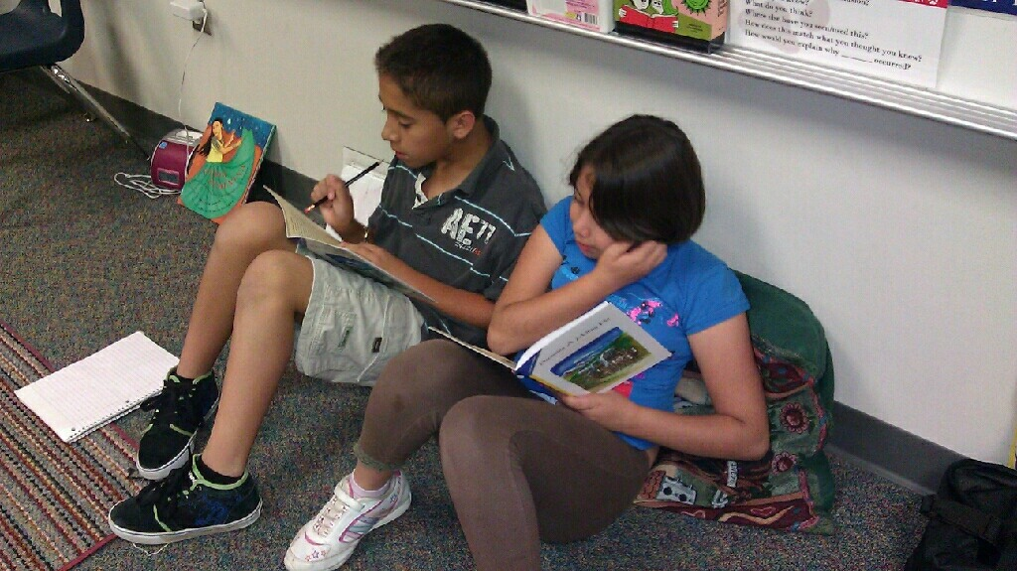

Slide 21
Video: 1st Grade Bilingual Pairs & Groups
Show Video

Slide 22
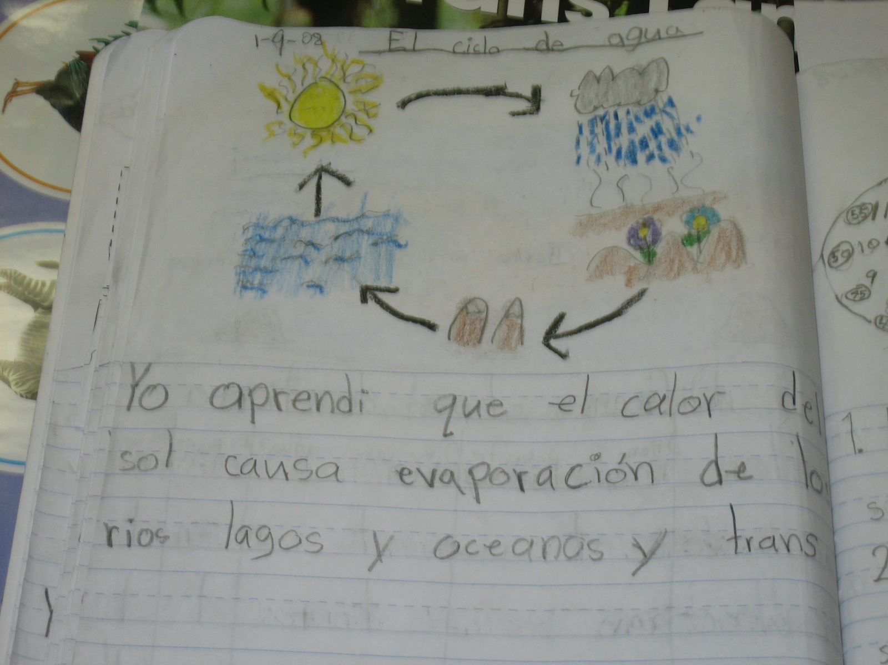

Slide 23
1st Grade Paired Work
Reading and Writing Across the Curriculum!
Copyright © 2017-Dual Language Training Institute. All Rights Reserved.

Slide 24
Benefits of Bilingualism for All Children Beneficios del Bilingüismo Para Todos Los Niños
Parents should support their children through home-school collaboration
Los padres deben apoyar a sus hijo a través de la colaboración entre el hogar y la escuela
Learning Advantages (Academic Success!)
Ventajas de aprendizaje (¡Exito académico!)
Value and Respect of one’s Own Language and Other Languages and Cultures
Valor y respeto del propio idioma y otros idiomas y culturas
Economic Advantages (job market opportunities)
Ventajas economicas (oportunidades en el mercado laboral)

Slide 25
Video: PSJA ISD Secondary DLE
Show Video

Slide 26
Thank you for your participation!
¡Gracias por su participacíon!
www.dltigomez.com

